Slide 1
COMPILER DESIGN LABORATORY · REVIEW 1
Project Proposal and Design Review
Making of a compiler
Submitted by Rishit Mittal · Reg. No. 24BCT0068 · B.Tech Computer Science(IoT) · Faculty: Dr. RANJITH KUMAR S · VIT Vellore
CODE REPO:https://github.com/RMIITAL007/rishit-s-compiler-edulang/tree/main

Slide 2
OVERVIEW
Project Overview
I’m building a custom programming language and compiler from scratch, and honestly, that’s what makes this project so exciting for me. I get to take the whole journey from source code all the way to execution.
What I really like is that it doesn’t feel like a black box. I can see every stage clearly, get helpful feedback when something breaks, and actually understand how all the pieces connect.
I chose compiler design because I’ve always wanted to see how code really becomes something a machine can run.
It also gives me a great way to experiment, test ideas, and learn the language-processing steps in a hands-on way while building something I can truly call my own.

Slide 3
PROBLEM & MOTIVATION
Problem Statement & Motivation
A lot of language-processing tools feel like a complete black box: you write code, press run, and all the interesting steps disappear behind tokenising, parsing, and transformations you can’t actually see. That lack of visibility makes the whole process feel mysterious instead of understandable.
That’s a big reason I want to build my own compiler. I want something open, clear, and educational — a pipeline where every phase is visible, easy to follow, and genuinely useful for learning how programming languages are processed from start to finish.

Slide 4
OBJECTIVES
Project Objectives
1
Design a Language
I want to shape a small custom language that feels intuitive and fun to use — something I’d actually enjoy picking up, with syntax that clicks quickly.
2
Build the Language Reader
I’m excited to build the lexer and parser so I can watch source code get broken down and turned into a clean Abstract Syntax Tree (AST), step by step.
3
Make It Meaningful
I want to set up a symbol table and add semantic checks, including type checking, so the language starts to feel smart, reliable, and ready for real programs.
Bring It to Life
4
Next, I want to generate intermediate representation, add some basic optimisations, and finally interpret finished programs so the whole pipeline actually runs end to end.
5
Guide Users Through Mistakes
I’d love to finish by making the error messages genuinely helpful and stage-specific, so it’s easier to spot issues, fix them, and keep moving forward.

Slide 5
SCOPE
Project Scope
✅ What I'm building
❌ What I'm leaving out
A small custom language with variables, data types, expressions, and statements
Conditions and loops only where they genuinely make the language more useful
The full front end: lexical analysis and parsing
AST construction and a symbol table
Semantic analysis and intermediate code generation
Basic optimisation and execution
Production-grade compiler features
Heavy-duty industrial optimisations
A full standard library
Support for multi-file projects
Advanced type inference
For me, this is the realistic version of the project. I want a complete, working educational pipeline that I can actually finish and understand deeply, not a massive compiler that gets too broad to stay thoughtful.

Slide 6
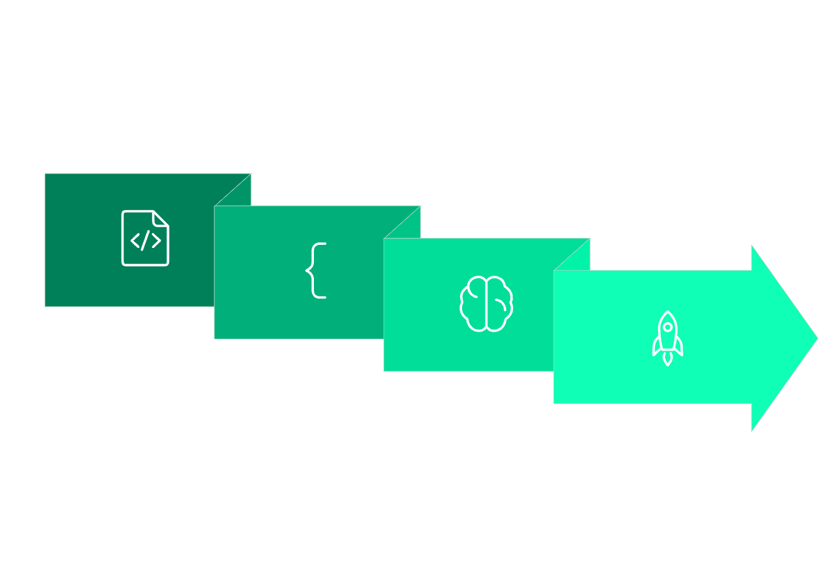
BACKGROUND
Compiler Pipeline — Key Concepts
When I think about the compiler pipeline, I imagine the program moving through a handful of checkpoints, kind of like how I’d explain it to a friend. Each stage takes the code in its own way, tidies it up, and hands it off to the next one until everything is ready to run.
Parsing
Optimize & Run
Lexical
Semantic
Each stage transforms the program representation, passing structured output to the next. Errors are caught and reported at the stage where they occur.

Slide 7
LANGUAGE DESIGN
Proposed Language & Specification
I’m excited to share this first pass at the language — it’s still rough, but that’s what makes this stage so fun because I get to shape its rules, feel, and personality as I go.
Here’s a simple example to show how the language is meant to look and how the basic rules fit together. The code and grammar below are still a starting point, but they should make the idea feel a lot more concrete.
Example Source Code
Initial Grammar (subject to evolution)
int a = 10;
int b = 20;
int result;
result = a + b * 2;
print(result);
program → statement*
statement → declaration | assignment
| printStatement
expression → term ((+ | -) term)*
term → factor ((* | /) factor)*
factor → NUMBER | IDENTIFIER
| '(' expression ')'
Token Categories
Keywords: int, print
Identifiers: a, result
Literals: 10, 20, 2
Operators: +, *, =
Delimiters: ;, (, )

Slide 8
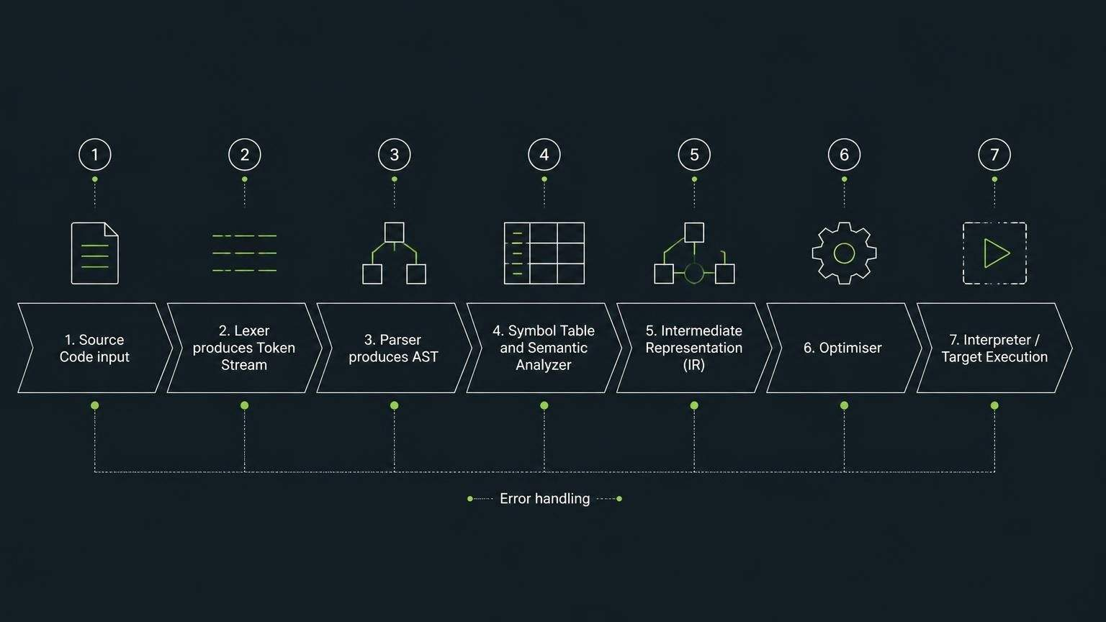
ARCHITECTURE
System Architecture
I designed this system as a clear path for code to follow: first I take the raw source, then I split it into tokens, build structure from those tokens, check the meaning, and finally turn everything into something executable. I made each stage deliberately separate so the architecture stays easy to reason about, and I built error handling into the flow from the start so issues get caught as early as possible.
Error handling is integrated at every stage — lexical errors, syntax errors, and semantic errors are caught and reported with source-location information before halting or continuing.

Slide 9



METHODOLOGY & STACK
Development Methodology & Technology Stack
First, I got something simple running
Then I taught it how to reason about code
After that, I focused on making it solid
I started with the language shape, then built the lexer, parser, and AST step by step.
I focused on the symbol table, semantic analysis, IR, and interpreter — where it started feeling real.
I polished optimisation, connected the pieces, and leaned on testing, debugging, and documentation.
Technology Stack
Initial Prototype — Lexer Output
Language: C++
Build: CMake
Version Control: Git
IDE: VS Code
Testing: Unit testing framework
Tools: Flex/Bison or ANTLR
Input: int a = 10;
Output:
TOKEN: INT
TOKEN: IDENTIFIER(a)
TOKEN: ASSIGN
TOKEN: INTEGER(10)
TOKEN: SEMICOLON
LEXER ✓
BASIC PARSER ✓
AST PROTOTYPE ✓

Slide 10
OUTCOMES & CONCLUSION
Expected Outcomes & Review 1 Conclusion
A Solid Starting Point
What Comes Next
Where I’m Headed
Honestly, it feels good to look back and see real progress. Getting the lexer, parser, and AST working gave me something tangible to build on, and that made the whole project feel much less abstract.
I know there’s still a long road ahead, but I feel more confident now than when I started. Semantic analysis, IR generation, and the rest of the pipeline no longer feel like distant ideas — they feel like the next steps I can actually reach.
What excites me most is seeing this grow into a compiler that feels complete and purposeful. I want it to be something I can be proud of — something that works well, teaches me a lot, and reflects the effort I’ve put into it.
Thank You

